Slide 1
Cells & Classification

Slide 2
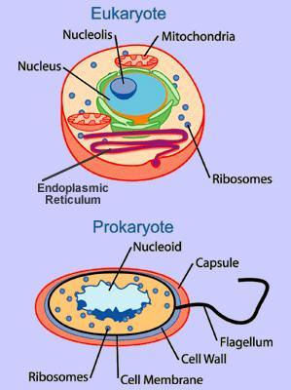
2 Types of Cells
Prokaryotic
simplest type of cell
does NOT have a nucleus
tough cell wall allows them to survive in harsh conditions
Eukaryotic
more complex cell
has a nucleus
has organelles

Slide 3
What do scientists use to observe cells?
A microscope!

Slide 4
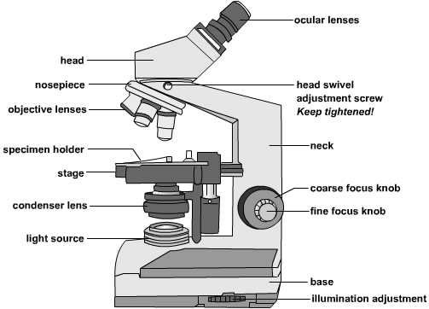
Two Types of Microscopes
Simple Microscope
Compound Microscope
uses a single convex lens that provides a magnified view of an object
Example: a hand lens
uses two magnifying lenses:
1. an objective lens placed near the object being viewed
2. an eyepiece lens placed near the eye of the viewer

Slide 5
Classification of Living Things
Scientists use classification to group plants and animals according to their similarities and differences.
They are grouped based on the features they share.

Slide 6
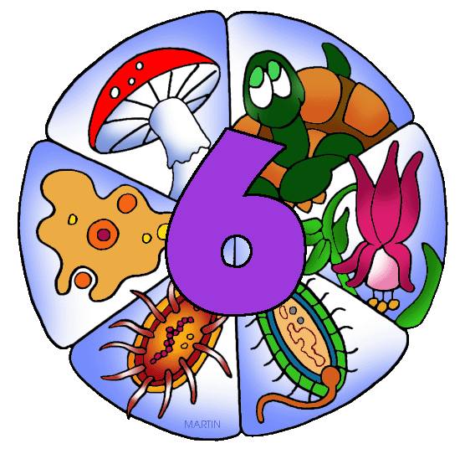
6 Kingdoms
Fungi Kingdom
Plant Kingdom
Protist Kingdom
Animal Kingdom
Eubacteria Kingdom
Archaebacteria Kingdom

Slide 7
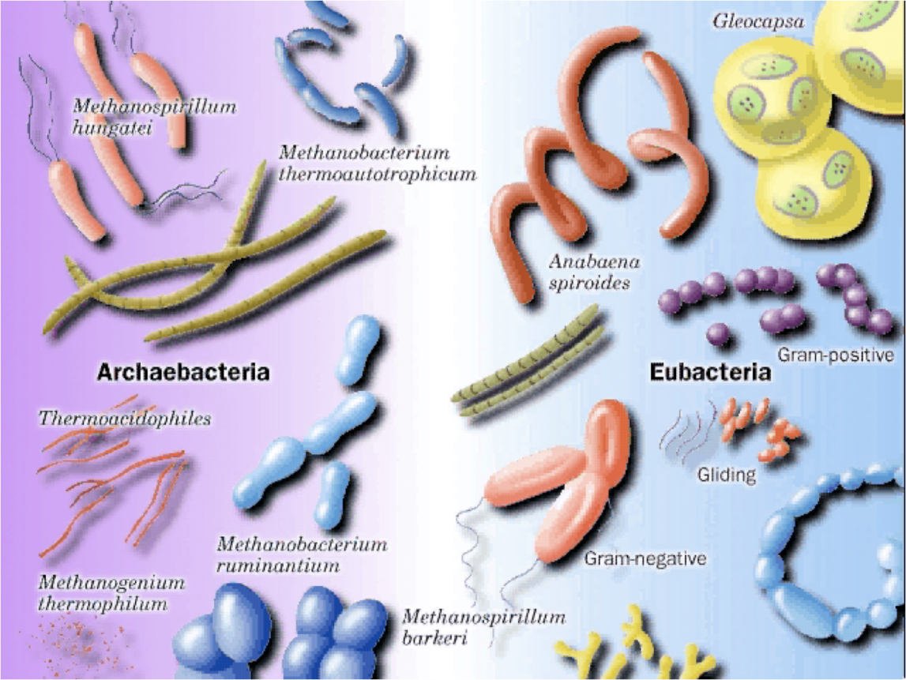
Eubacteria Kingdom
bacteria
weaker cell walls
much more common than archaebacteria
found everywhere on Earth including the human body

Slide 8
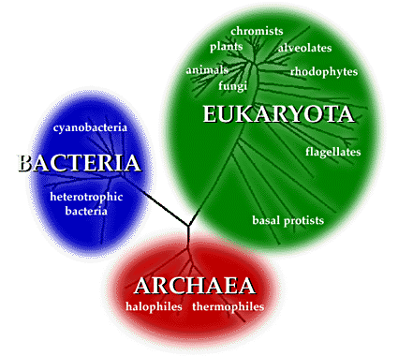
Archaebacteria Kingdom
bacteria
extremely strong material in cell wall which allows them to live in deep ocean vents and volcanoes

Slide 9
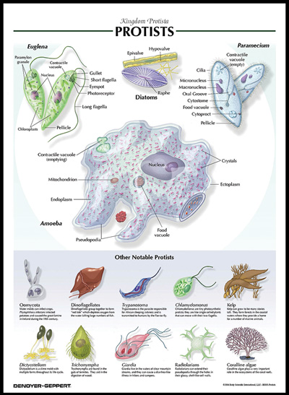
Protist Kingdom
mostly one celled organisms
eukaryotic
Includes any organism that is not a bacteria, plant, animal, or fungus

Slide 10
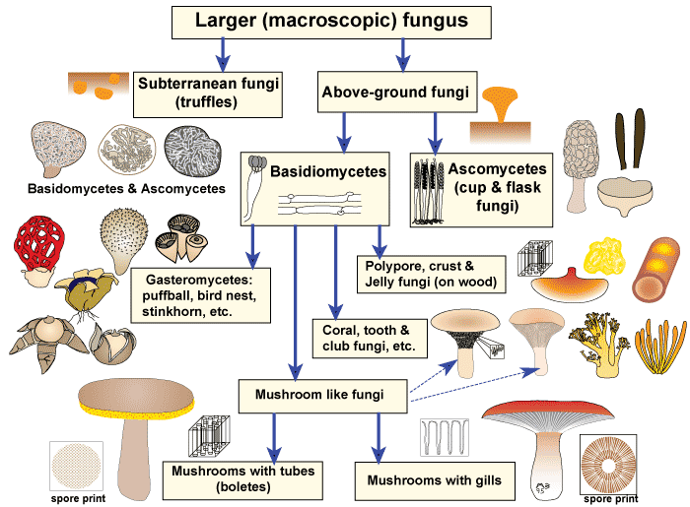
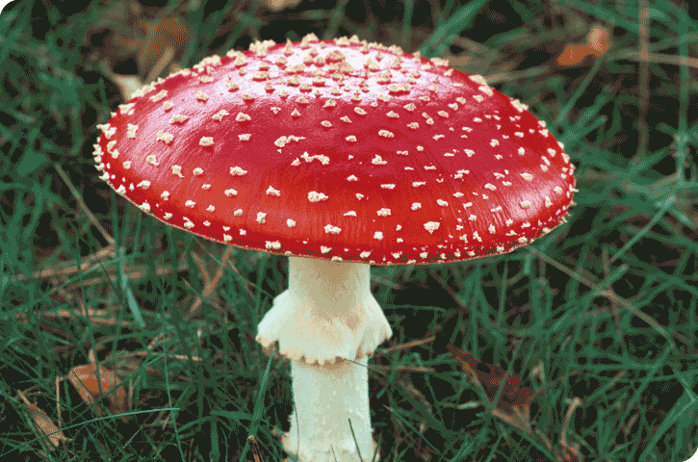
Fungi Kingdom
organisms that have more than one cell
eukaryotic
feed off dead organic material
most are consumers
example: mushrooms

Slide 11
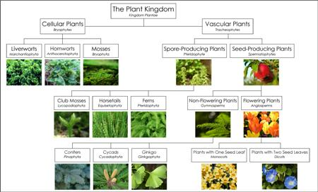
Plant Kingdom
plants
provides food & oxygen
for animals
almost all are multicellular
& eukaryotic
able to make food for
themselves
most are considered producers
Two Types of Plants:
1. Vascular Plants: contain tissues through which water moves up and food moves down
Examples: ferns, horsetails, pine trees, roses, maple trees
2. Nonvascular Plants: does not contain tissue through which water and food moves
Examples: mosses, liverworts, and hornworts

Slide 12
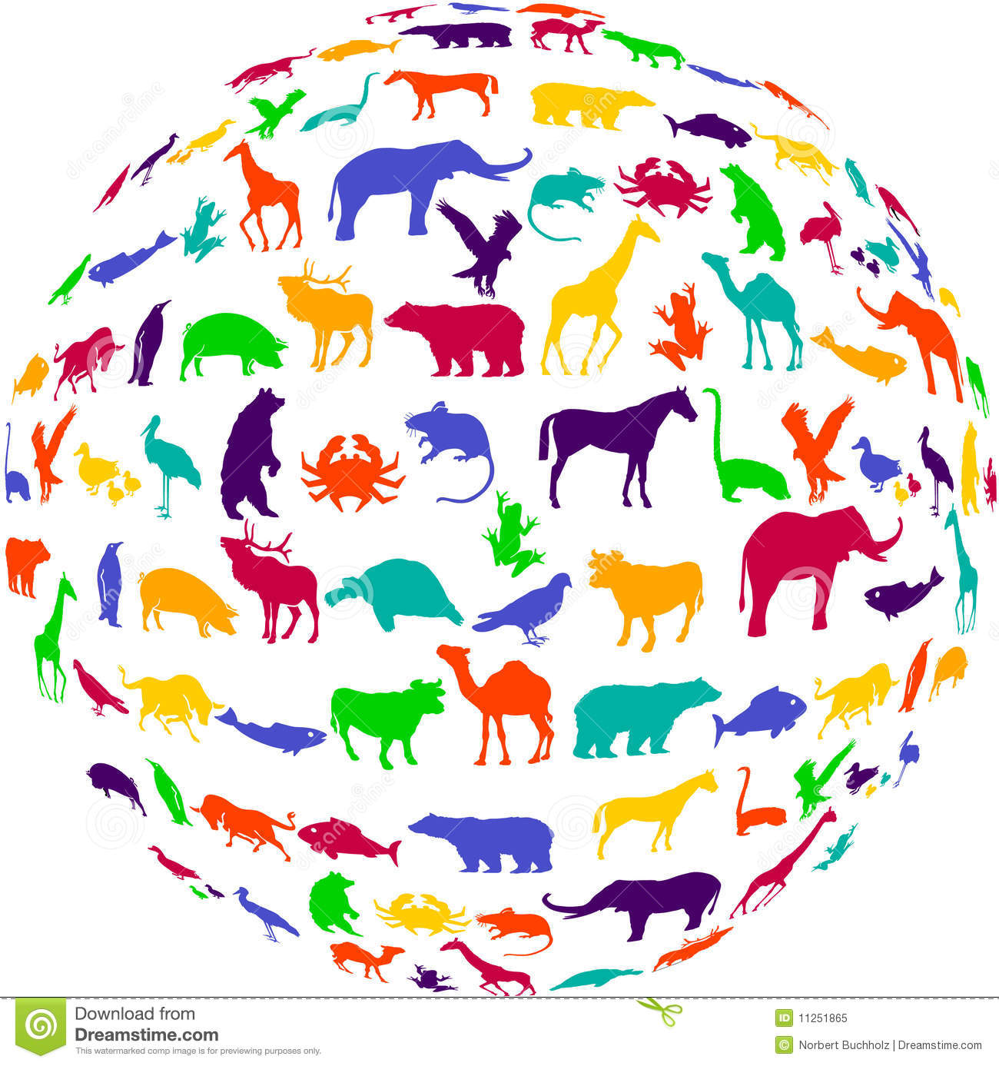
Animal Kingdom
Humans & animals
Multicellular
eukaryotic cells
dependent on plants or other animals for food
all considered consumers
1. Vertebrates: fish, mammals, amphibians, reptiles, birds
2. Invertebrates: Sponges, Anemones & Jellyfish, Worms, Snails, Clams, & Octopuses, Sea Star & Urchins, Insects, Spiders, Ticks, Lobsters, Crabs, & Crayfish.

Slide 13
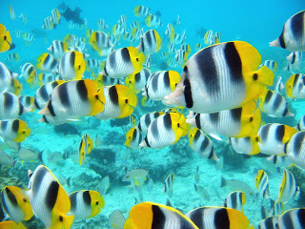
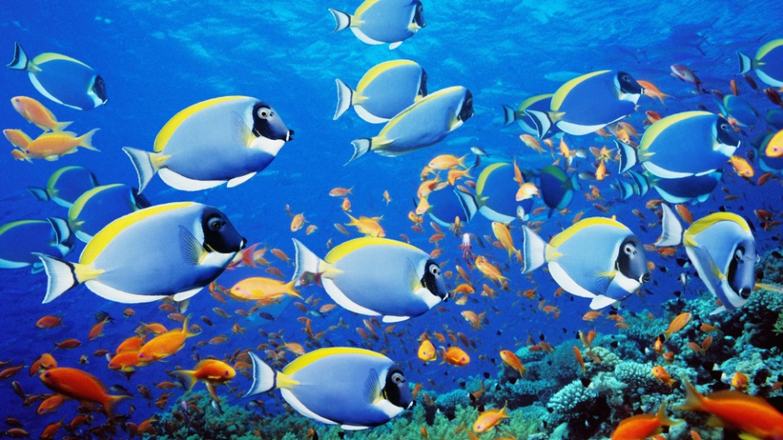
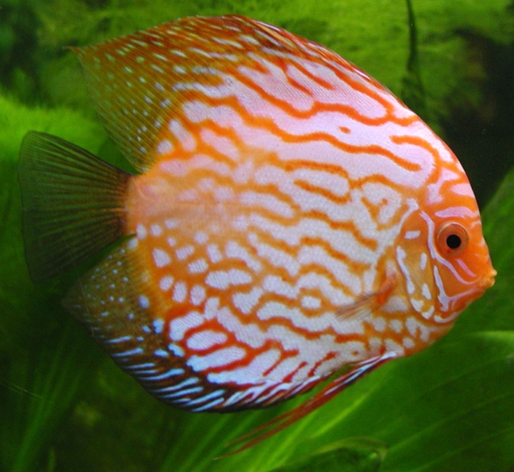
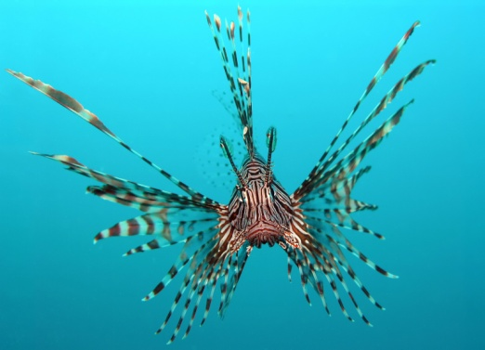
VERTEBRATES- FISH
Are cold-blooded
Have gills and scales
Live in water

Slide 14
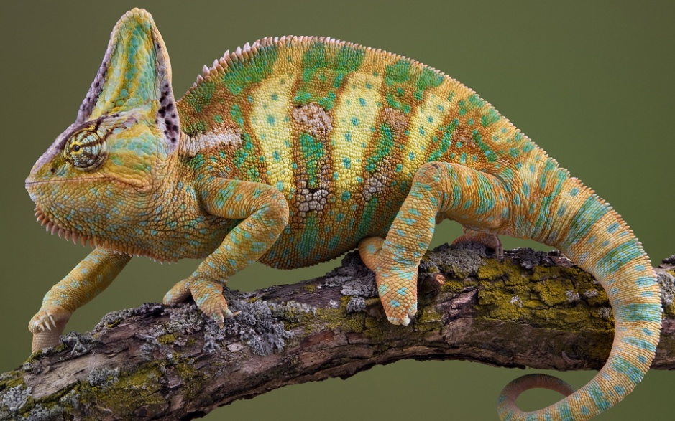
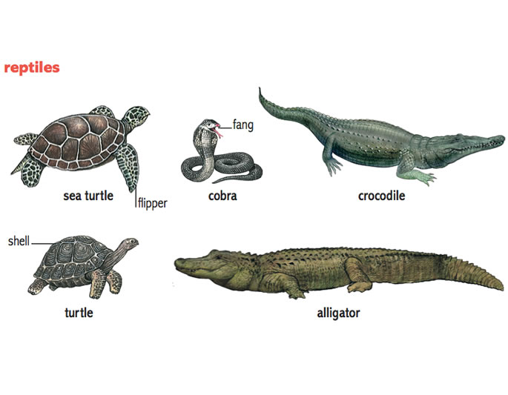
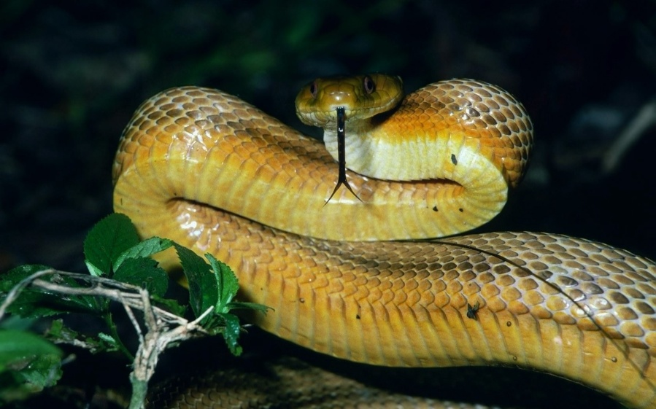
VERTEBRATES- REPTILES
Have scales
Live on land
Are cold-blooded
Usually lay eggs

Slide 15
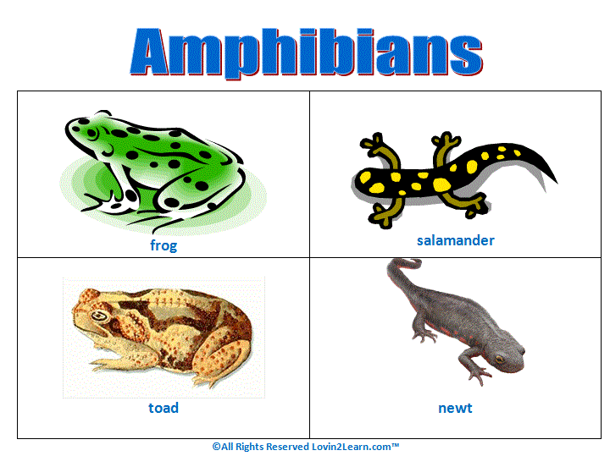
VERTEBRATES- AMPHIBIANS
Live in water and on land
Are cold-blooded
Have smooth skin
Lay eggs

Slide 16
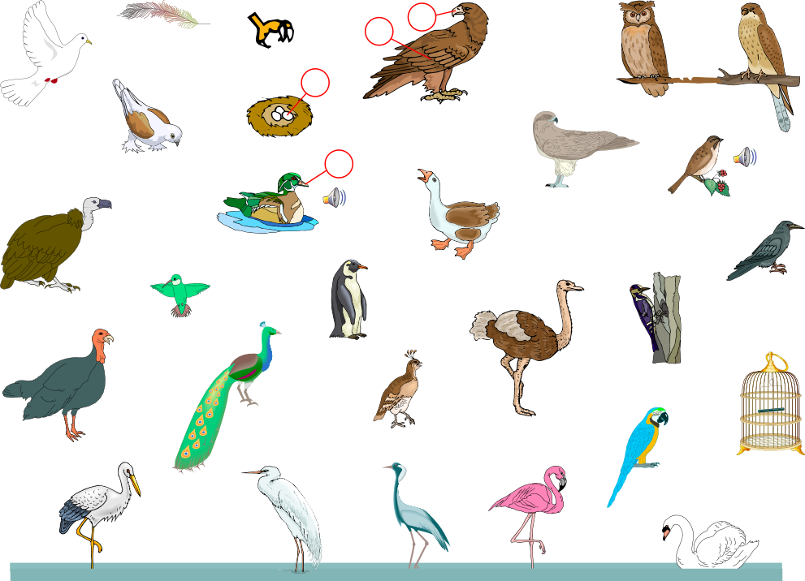
VERTEBRATES- BIRDS
Have feathers
Are warm-blooded
Have hollow bones and most can fly
Lay eggs

Slide 17
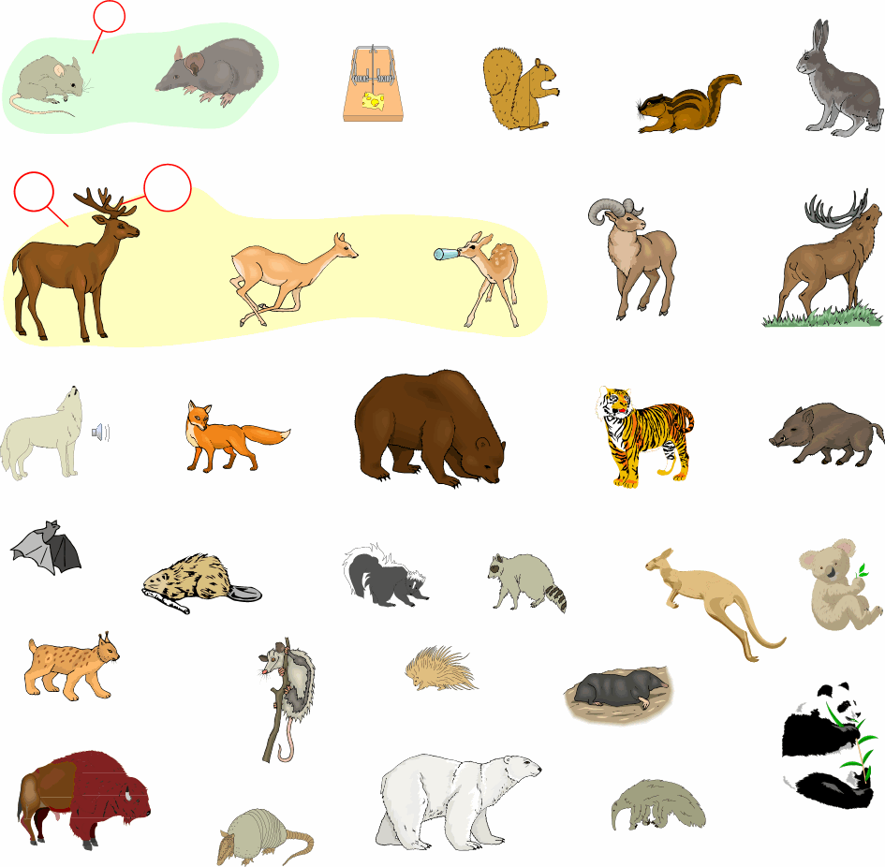
VERTEBRATES- MAMMALS
Have hair or fur
Are warm-blooded
Feed milk to their young
Bear live young
(except monotremes – mammals that lay eggs)

Slide 18
 | Archaebacteria | Eubacteria | Protist | Fungi | Plant | Animal
Number of Cells | unicellular | unicellular | both | both | multicellular | multicellular
Mode of Nutrition | Consumer & Producer | Consumer & Producer | Consumer & Producer | consumer | Producer | Consumer
Cell Wall | Yes | Yes | Some | Yes | Yes | No
Types of Cells | Prokaryote (no nucleus) | Prokaryote (no nucleus) | Eukaryote (nucleus) | Eukaryote (nucleus) | Eukaryote (nucleus) | Eukaryote (nucleus)
Examples | survives in extreme places such as hot springs and volcanoes | Everywhere | Amoeba, paramecium, euglena | Mush yeast | Ferns horsetails, | Lion, tiger, bear

